Slide 1

Pharmacy Management System

Slide 2
Agenda
Introduction
Features
Technology
EDA
Conclusion

Slide 3
Introduction
The Pharmacy Management System is a software solution that is designed to help pharmacists manage their inventory, customers, and medication dispensing.
The system is built using Java Swing, a GUI toolkit for Java, and is connected to a MySQL database.
The Pharmacy Management System provides a user-friendly interface that makes it easy for pharmacists to perform tasks like adding, updating, and removing drugs, managing inventory, and customer information.

Slide 4
Features
Manage inventory: The system allows pharmacists to manage their inventory by tracking drug quantities, expiration dates, and ordering needs.
Add, update, and remove drugs: The system allows pharmacists to easily add, update, and remove drugs from their inventory.
Manage customer information: The system allows pharmacists to manage customer information, such as prescription history, contact information, and insurance information.
View and generate reports: The system allows pharmacists to view and generate reports on various aspects of their operations, such as drug sales, inventory levels, and customer information.

Slide 5
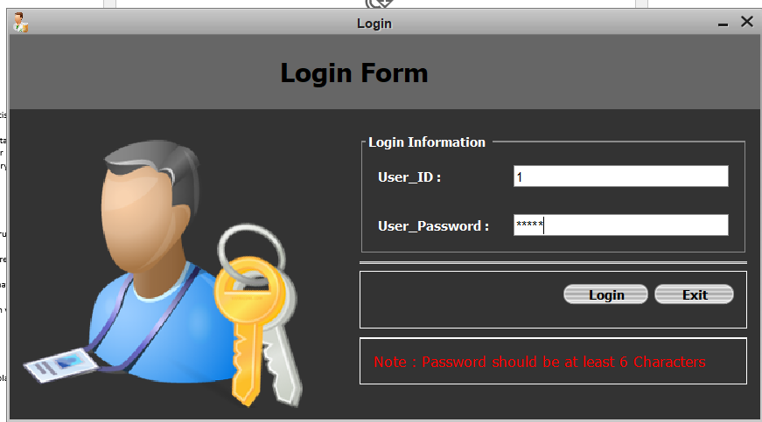
Technology
Java Swing: Java Swing is a GUI toolkit for Java that allows developers to create rich, cross-platform user interfaces.
MySQL: MySQL is a relational database management system that is commonly used in web development.

Slide 6
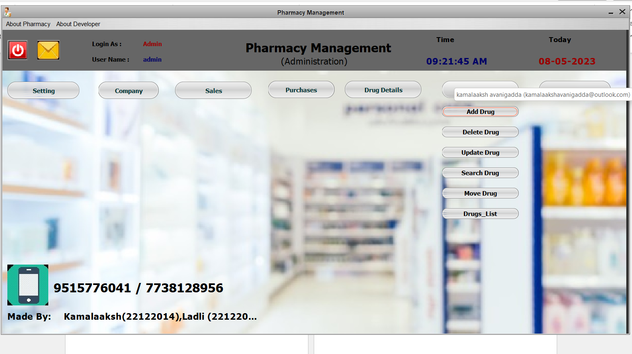
Demo

Slide 7
EDA

Slide 8
Two Content Layout with Table
Class | Group A | Group B
Class 1 | 82 | 85
Class 2 | 76 | 88
Class 3 | 84 | 90
First bullet point here
Second bullet point here
Third bullet point here

Slide 9
Benefits
Improved patient care:
By providing faster, more accurate service, the PMS helps improve the quality of patient care and increase patient satisfactory.
Better inventory management:
The system helps pharmacists manage their inventory more effectively, which can help reduce waste, prevent stockouts.

Slide 10


Conclusion
The Pharmacy Management System is a powerful software solution that can help pharmacists manage their operations more efficiently, reduce errors, and improve the quality of patient care.
Overall, the Pharmacy Management System is a valuable tool for any pharmacy that is looking to improve its operations and provide better service to its customers.

Slide 11
THANK YOU
Presented By-
Kamalaaksh_22122014
Ladli Bhagat_22122015

